Slide 1
Brain tumour segmentation using Unet

Slide 2
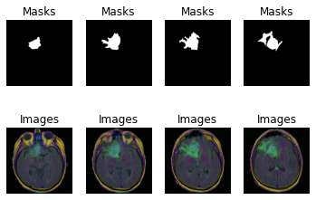
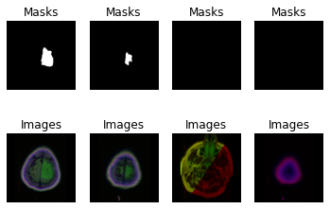
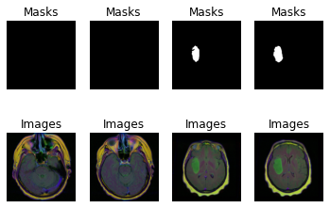
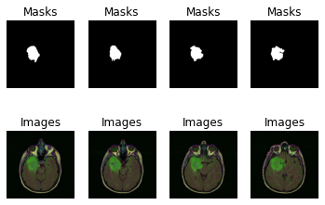

Slide 3
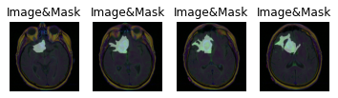
Brain tumour data
Data is FLAIR MRI images and labelled masks.
Mask will show the area of tumours in the brain
Images are transverse plane.
URL: https://www.kaggle.com/datasets/mateuszbuda/lgg-mri-segmentation

Slide 4
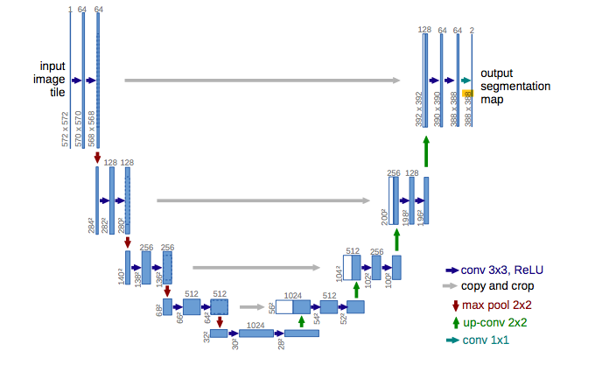
Methods
The Deep learning model which is widely used to image segmentation is Unet: https://arxiv.org/abs/1505.04597
Input is RGB images
Output is binary images

Slide 5
Model training
Loss function: Binary CrossEntropy
Metrics: Accuracy (use IOU would be better)
Setting early stop point and save the best model during training
Use image augmentation

Slide 6
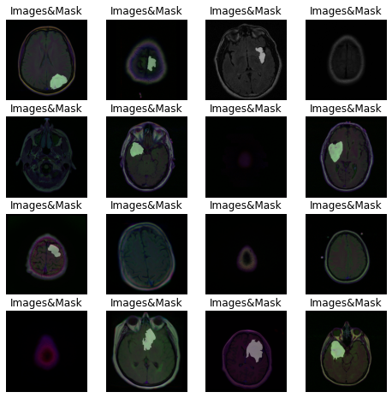
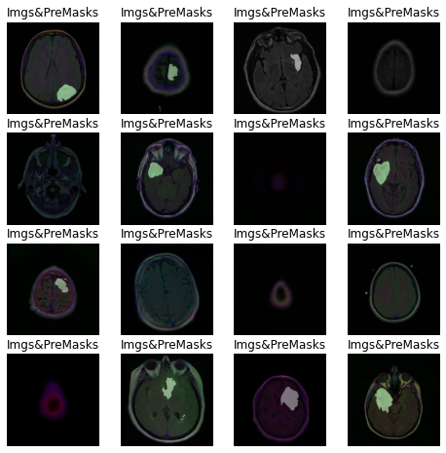
Results
Images and labelled masks
Images and predicted masks

Slide 7
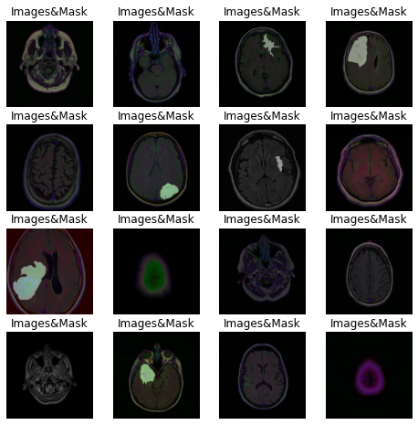
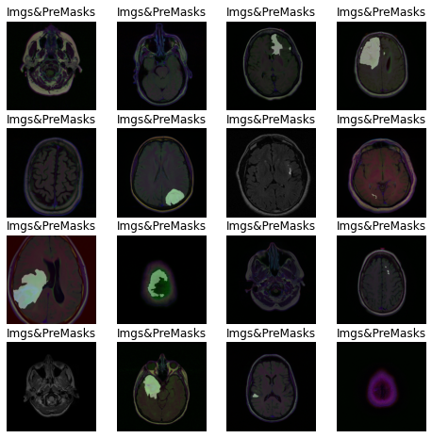
Results
Images and labelled masks
Images and predicted masks

Slide 8
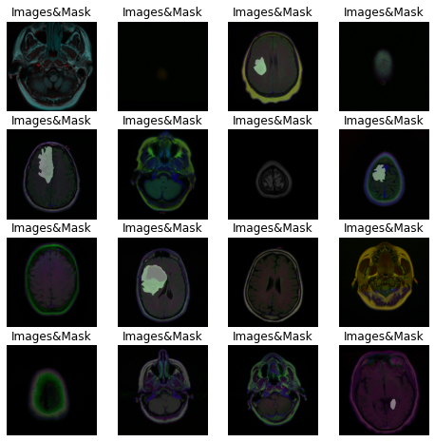

Results
Images and labelled masks
Images and predicted masks

